Slide 1

Actually gathering data – you’ve done it before
Week 2 HRA2

Slide 2
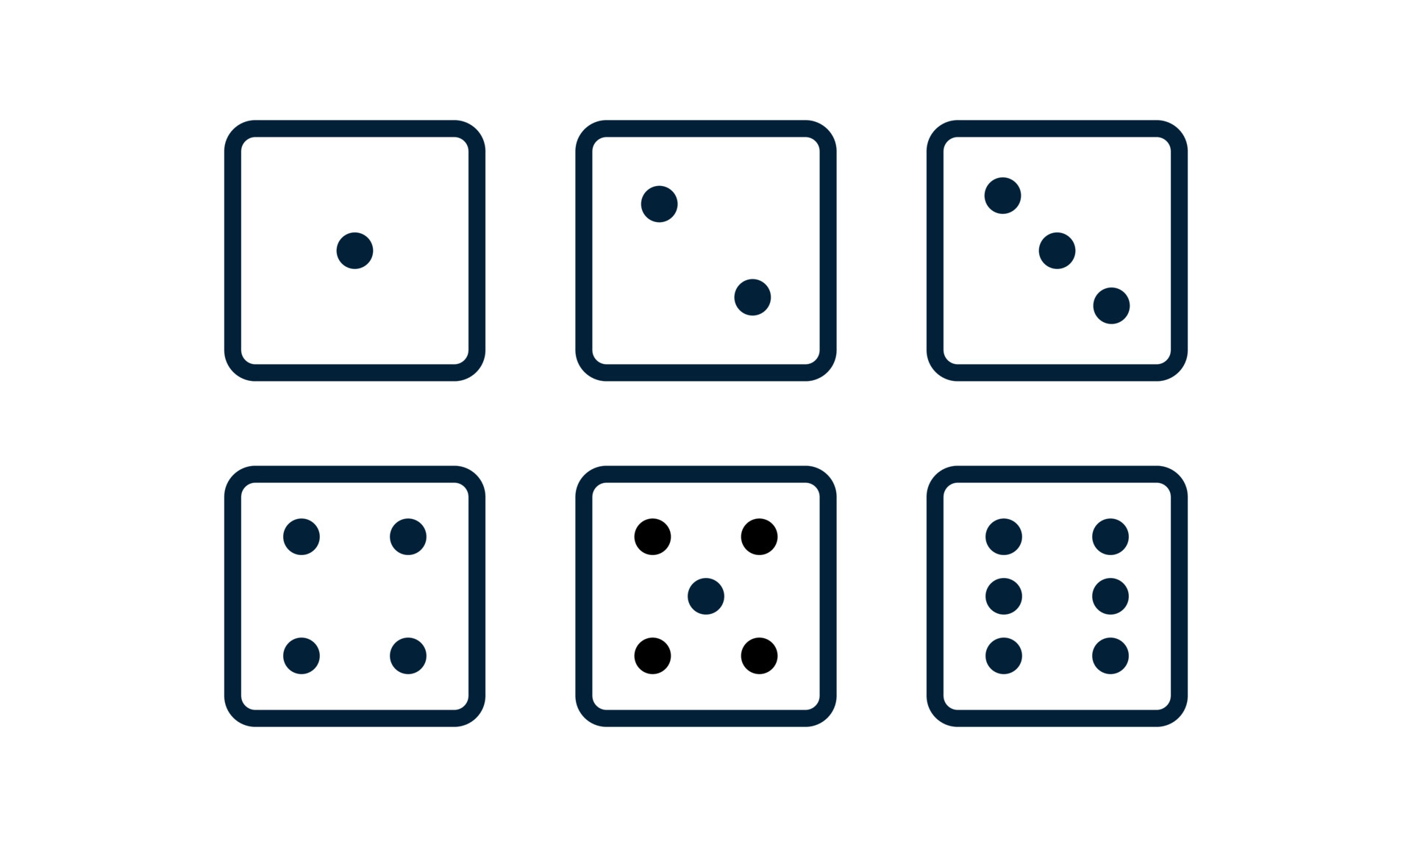
NUANCE!
Data generating process
1/6
1/6
1/6
1/6
1/6
1/6
[Added = 1]
1*1/6
2*1/6
3*1/6
4*1/6
5*1/6
6*1/6
= 3.5
Data generating process
1/2
1/10
1/10
1/10
1/10
1/10
[Added = 1]
1*1/2
2*1/10
3*1/10
4*1/10
5*1/10
6*1/10
= 2.5

Slide 3

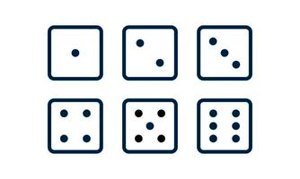

Data collection choices and measurements: research design
Choices on data collection and measurement:
sampling, validity and reliability
Data
Generating
Process
Statistics:
Type I and II errors
H₀ or H₁
General population:
all observations possible
Your data/observations

Slide 4
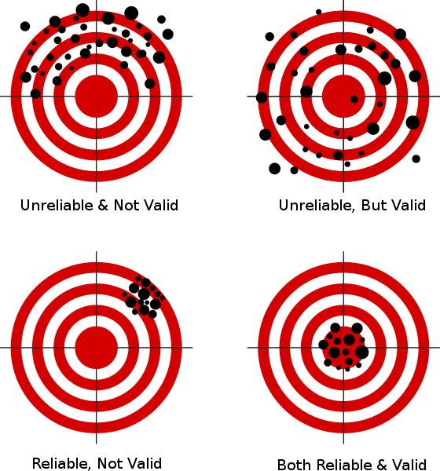
Recap: Validity and Reliability

Slide 5

Remember when you were 2 years old?

Slide 6

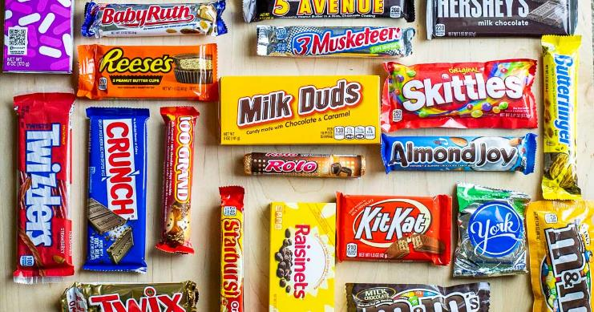
You already did some research yourself!
Formulate a (management) problem to research
Describe what you want to investigate (research question)
Indicate what methodology you will use
Describe what you will do to collect data
What result do you expect?
Formulate a Null and an alternative hypothesis H0 and Ha

Slide 7
Describe what could impact the validity and reliability of your research design

Slide 8
Recap Sampling
What sampling methods have you studied?
What is the difference between probability and non-probability sampling?

Slide 9

Which belongs to which? Probability vs non-probability methods
Clustered Sampling
Simple Random Sampling
Snowball Sampling
Self-Selection Sampling
Quota Sampling
Systemic Sampling
Convenience sampling
Stratified Sampling

Slide 10
Which belongs to which? Probability vs non-probability methods
Clustered Sampling
Simple Random Sampling
Snowball Sampling
Self-Selection Sampling
Quota Sampling
Systemic Sampling
Convenience sampling
Stratified Sampling

